Slide 1
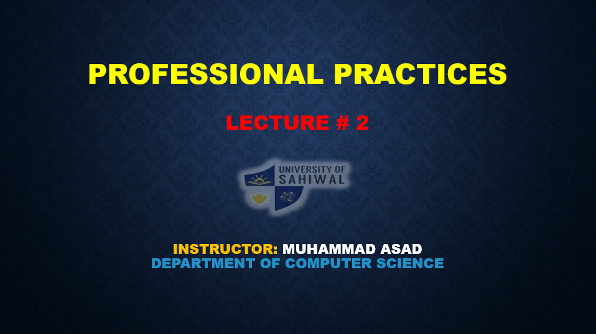

Professional Practices lecture # 2 Instructor: Muhammad asad department of computer science

Slide 2
Key Learning Point :-
- Why are managers important?
- Organization level of management
- Managerial skills

Slide 3
WHY ARE MANAGERS IMPORTANT?
A great boss can change your life, inspiring you to new heights both professionally and personally — and — Energizing you and your team to together overcome new challenges bigger than any one of you could tackle alone.
The first reason managers are important is that organizations need their managerial skills and abilities more than ever in these uncertain, complex, and chaotic times.

Slide 4
Another reason managers are important to organizations is that they’re critical to getting things done.
The reason managers are important to organizations is that to maintain the quality of the relationship. The researcher found that most important variable in employee productivity and loyalty isn’t pay benefits or workplace environment — it’s the quality of the relationship between employees and their direct supervisors.

Slide 5
WHO IS A MANAGER?
They were the organizational members who told others what to do and how to do it.
A manager is someone who coordinates and oversees the work of other people so that organizational goals can be accomplished.
A manager’s job is not about personal achievement — it’s about helping others do their work.

Slide 6
LEVEL OF MANAGEMENT
Management means taking care of the processes within an organization in order to ensure it’s effective functioning. Obviously, if one person is asked to manage a whole organization, it would prove to be too herculean of a task.
The workload of management is divided into a hierarchy. Each person in the hierarchy is provided with just enough amount of authority and responsibility. Definitely, as we move up the hierarchy the authority and responsibility (and the salary too!) seems to increase.
This hierarchy creates an authority-responsibility relationship between individuals that rise to various levels of management, which further introduces superiors and subordinates (due to the difference in authority and responsibility) into the management system.

Slide 7
TOP MANAGEMENT
The top managers are the masterminds of all organizational policies. They are responsible for heading and putting forth the plans and ideas to ensure the welfare of the whole organization. Further, they are responsible for all activities and their implications for the society.
In fact, they are required to handle diverse elements and coordinate the activities of various departments to ensure that they always stay in line with the company’s objective.
Generally top officials like the chief executive officer, chief operating officer, president etc. constitute the top managers. It involves a lot of workload and commitment towards the organization.

Slide 8
MIDDLE MANAGEMENT
The main task of middle managers is to carry out plans which are a idea of top managers. Additionally, they are responsible for extracting work productivity out of first-line managers. The middle managers are subordinate to top managers and superior to first-line managers.
They are responsible for proper implementation of plans --- Laid out by the top managers. Also, they are required to ensure proper functioning of their department by assigning duties, ensuring that their department has proper personnel, motivating their subordinates and cooperating with other departments for smooth functioning of the organization.
Division heads, plant superintendents and operations managers qualify as middle managers.

Slide 9
FIRST-LINE, SUPERVISORY OR OPERATIONAL MANAGEMENT
Operational managers are at the bottom of the hierarchy. However, they are important for an organization root of the management system. This is because they directly interact with the workforce. Their job is to supervise the workforce and communicate the objectives.
Manage the work of nonmanagerial employees (workers). First-line managers may be called supervisors, department managers, or office managers.

Slide 10
Through First-line managers (Lower level management) efforts quality of output is maintained, wastage of materials is minimized and safety standards are maintained because they directly interact with the workforce, who typically are involved with producing the organization’s products or servicing the organization’s customers.
Further, the quality of the output depends on the loyalty, discipline, skills, ability and commitment by the workforce.

Slide 11
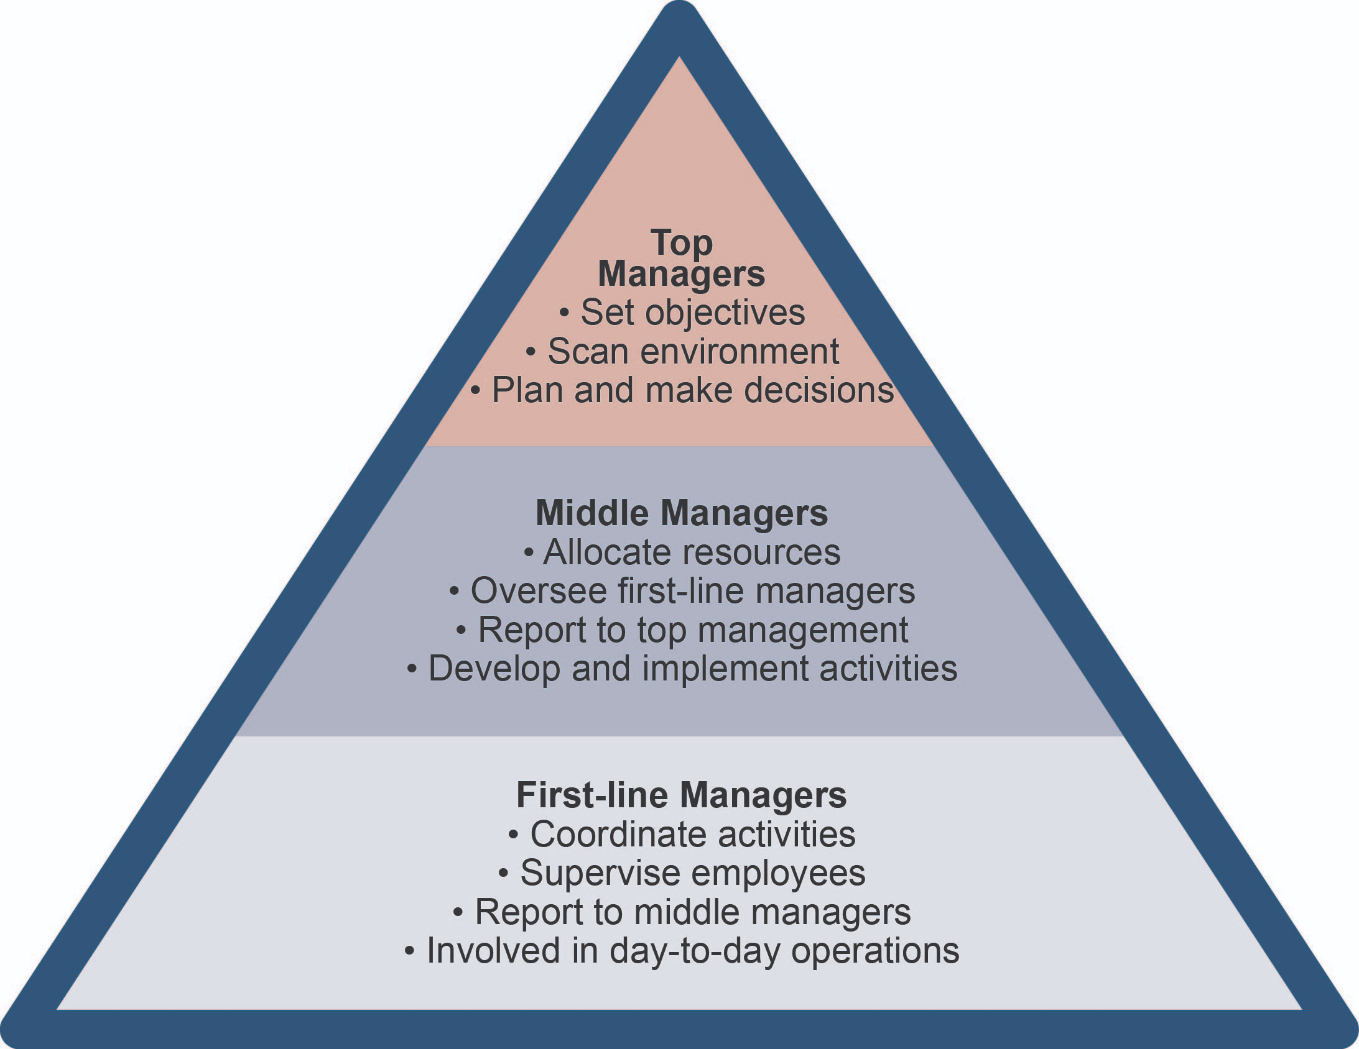

Slide 12
MANAGERIAL SKILLS
The managerial skills managers need three basic sets of skills.
1: TECHNICAL SKILLS
The skills that include knowledge of and proficiency in a certain specialized field Managers need to be technically competent.
They need to know how to plan, organize lead and control. Line managers need this skill the most while top manager will need minimum of technical skills.

Slide 13
2: INTERPERSONAL SKILLS/HUMAN SKILLS
Interpersonal skills include the ability to work well with other people both individually and in a group.
Mangers need good interpersonal skills, knowledge about human behaviors and group processes, ability to understand the feelings, attitudes and motives of others, and ability to communicate, clearly and persuasively. Human skills are very important at each level of management.

Slide 14
3: CONCEPTUAL SKILLS
Conceptual skills include the ability to think and to conceptualize about abstract and complex situations, to see the organization as a whole.
To understand the relationships among the various sub-units, and to visualize how the organization fits into its broader environment.
Conceptual skills include analytical ability, logical thinking, concept formation. They manifest themselves in things like good judgment, creativity, and the ability to see the big picture. Top mangers/CEO needs this type of skill the most.

Slide 15
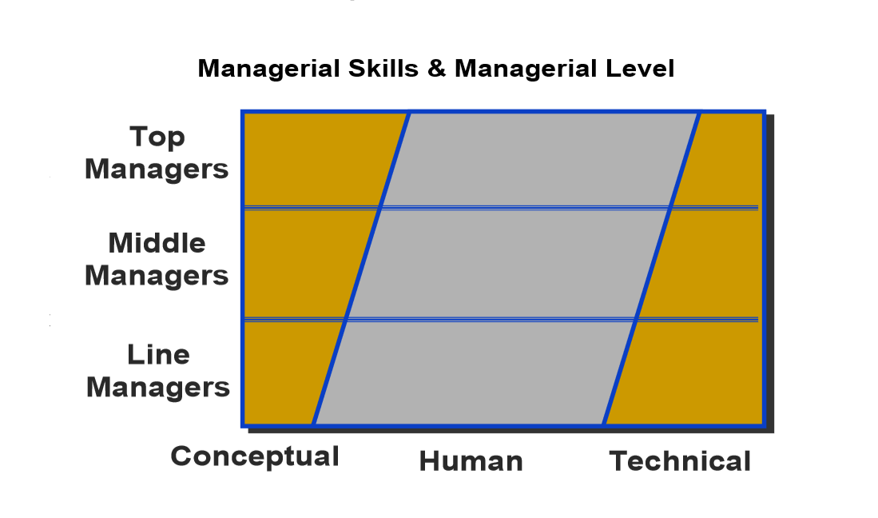

Slide 16

ANY QUESTION
You can contact me at: asadali@uosahiwal.edu.pk
Your query will be answered within one working day.

